Slide 1
High sensitivity cardiac troponin assay
Summary of webinar by released by Washington University and Barnes Jewish Hospitals
https://vimeo.com/440814898

Slide 2
Benefits of high sensitivity troponin
Measures the same cardiac specific troponin molecule as conventional assay, but can detect at levels 10 fold lower (better sensitivity)
Increased precision, <10% variability (better reproducibility)
Expedited diagnostic work up with rapid rule out protocols, shorter ER length of stay

Slide 3
New units
Conventional troponin ng/mL
HS troponin ng/L
Gender specific cutoffs for normal
Goal: whole integer values without confusing decimals
 | Old Units (ng/mL) | New Units (ng/mL)
LOQ | 0.004 | 4
Old 99th % URL | 0.03 | 30
New 99th % URL | 0.014 (F), 0.035 (M) | 14 (F), 35 (M)
70% PPV for AMI | 0.20 | 200

Slide 4
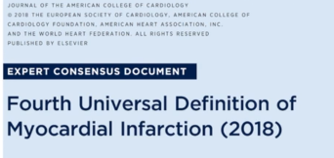
Myocardial infarction
Elevated troponin = myocardial injury
Acute injury = rise / fall of troponin
Chronic myocardial injury = elevated but static level of troponin
Acute myocardial infarction = acute injury + evidence of ischemia
Type I vs Type II MI
Rise / fall of troponin
Symptoms of ischemia
New ischemic ECG changes
Pathological Q waves
New loss of viable myocardium on imaging (new wall motion abnormality)
Coronary thrombus by angiography
Notes:
Detection of an elevated troponin value above the 99th percentile upper reference limit is defined as myocardial injury. The injury is considered acute if there is a rise and/or fall of the troponin values
Elevated troponin does not equate to myocardial infarction
The clinical definition of MI denotes the presence of acute myocardial injury detected by abnormal cardiac biomarkers in the setting of evidence of acute myocardial ischemia
Type I: plaque rupture or intraluminal thrombus
Type II: tachy, brady arrhythmias, aortic dissection, aortic valve disease, hypertrophic cardiomyopathy, shock, sepsis, anemia, respiratory failure, hypertension, vasospasm

Slide 5
Myocardial injury without ischemia
Cardiac contusion
Ablation
Pacing, defibrillation
Myocarditis
Rhabdomyolysis
Cardiotoxic agents
Renal failure
Cardiomyopathy
Sepsis
Pulmonary hypertension
Exercise
Acute stroke or SAH

Slide 6
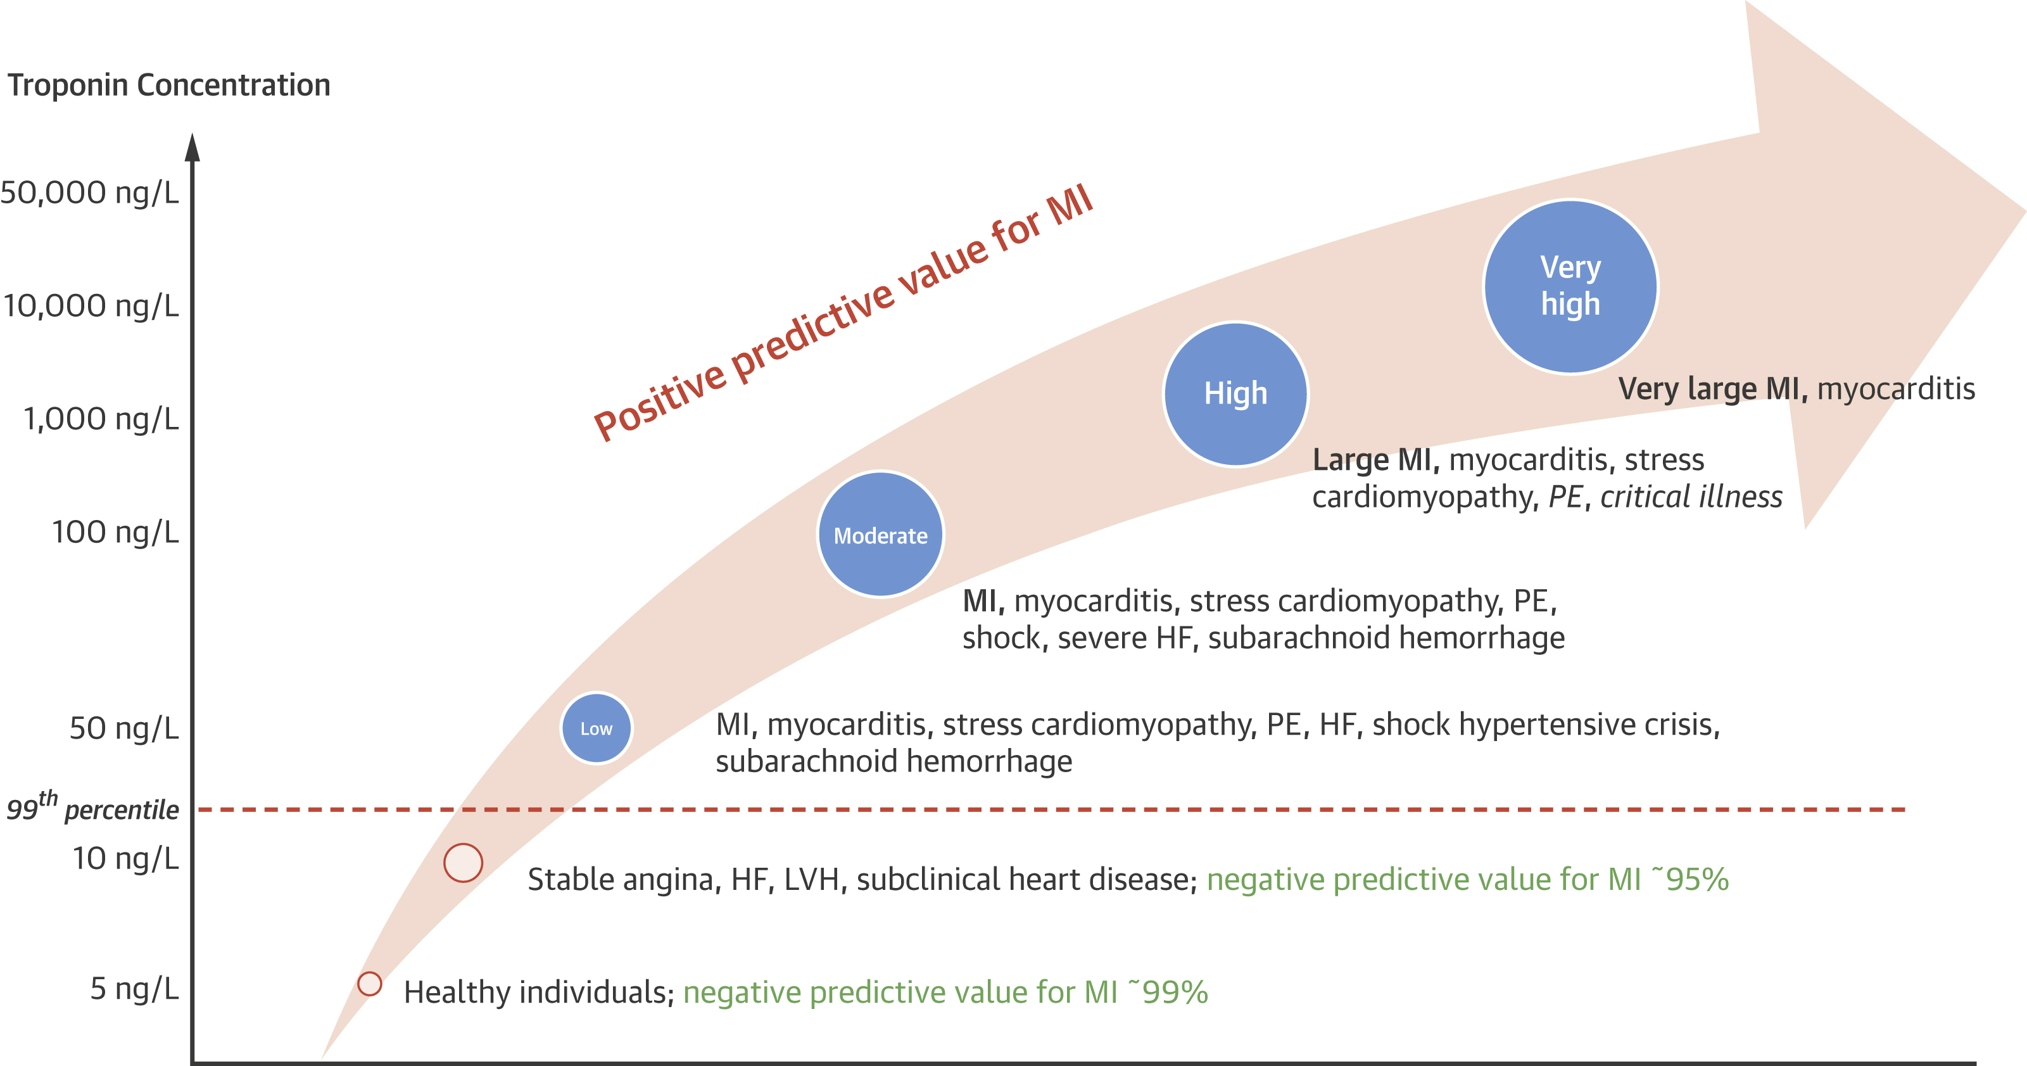
Troponin Elevation Magnitude
JACC 2019; 73:1059-77

Slide 7
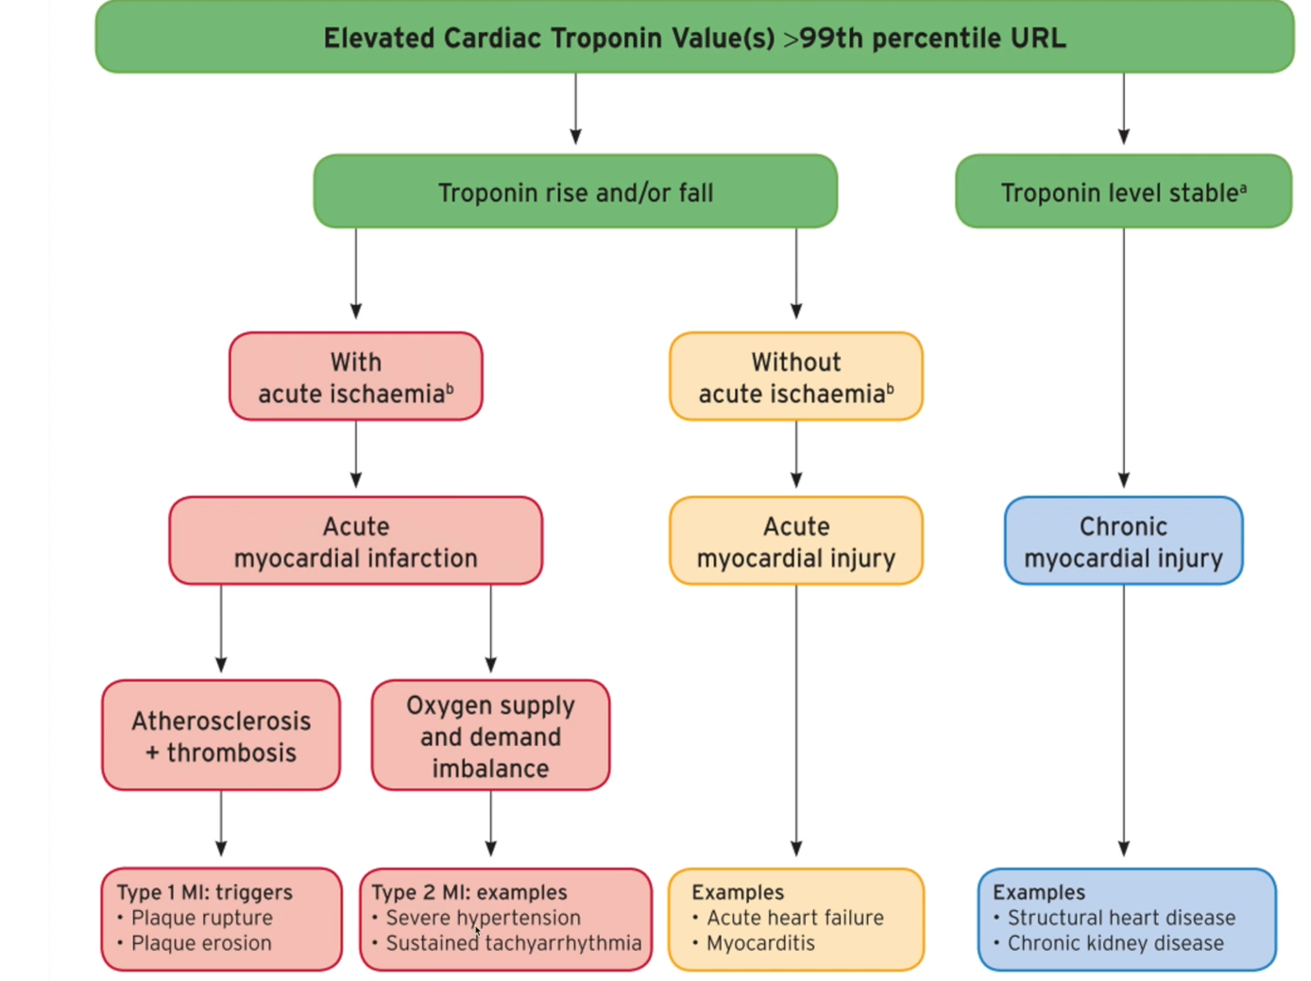

Slide 8
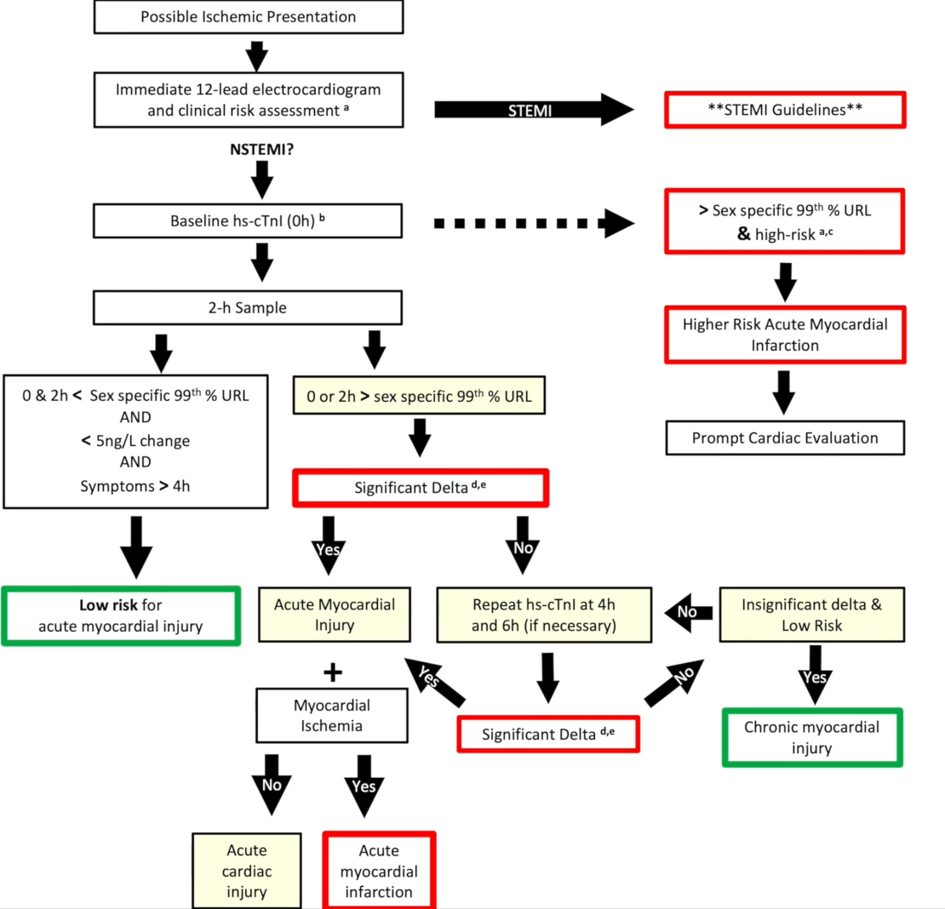

Slide 9

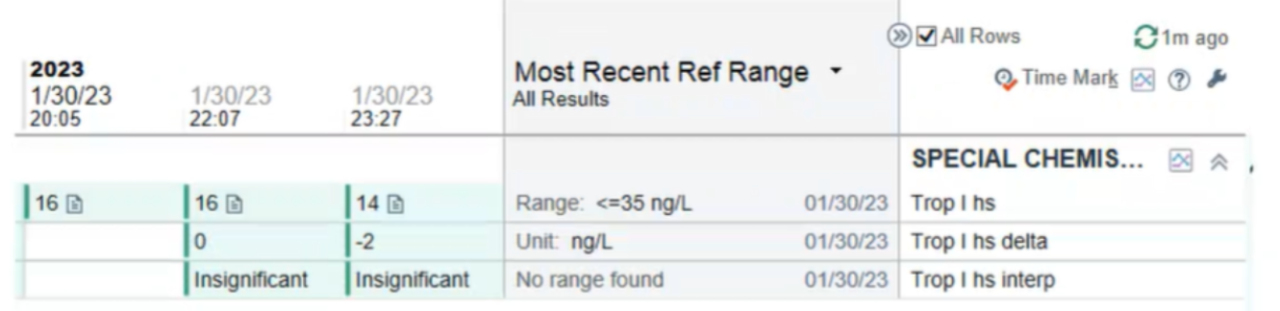
Delta troponin

