Slide 1
Alinity i STAT High Sensitivity Troponin-I (hsTnI_STAT)
May 24, 2023

Slide 2
AGENDA
Alinity i STAT High Sensitivity Troponin-I
*Intended use and Safety information
Heart disease and myocardial infarction (MI)
Diagnosis of MI: importance of biomarkers
What is troponin and how is it used in suspected MI?
How are hs troponin assays defined and reported?
Limitations of contemporary troponin assays
Comparison of Abbott contemporary and high sensitivity troponin-I (hsTnI) assays
Interfering substances
Alinity i hsTnI_STAT performance and specifications
ADD-140731-USA-EN |
August 14, 2023

Slide 3
Alinity i STAT High Sensitivity Troponin-I
  INTENDED USE
  The Alinity i STAT High Sensitivity Troponin-I assay is a chemiluminescent microparticle immunoassay (CMIA) used for the quantitative determination of cardiac troponin I (cTnI) in human plasma (lithium heparin) on the Alinity i System.
  The Alintiy i STAT High Sensitivity Troponin-I assay is to be used as an aid in the diagnosis of myocardial infarction (MI).
  IMPORTANT SAFETY INFORMATION
  Instructions must be carefully followed. Reliability of assay results cannot be guaranteed if there are any deviations from these instructions.
  For laboratory professional use only.
  For In Vitro Diagnostic Use
  Rx Only (For use by or on the order of a physician only)
  This product contains human-sourced and/or potentially infectious components. It is recommended that these reagents and human specimens be handled in accordance with the OSHA Standard on Bloodborne Pathogens.
Alinity i STAT High Sensitivity Troponin-I Package Insert: H14937R02
ADD-140731-USA-EN |
August 14, 2023

Slide 4

Heart disease and MI
Coronary Heart Disease is the leading cause of death in the US¹
Manifests most often in the form of Acute Coronary Syndrome (ACS): term used to describe Myocardial Infarctions (MI, heart attack) and unstable angina
Approximately 6-8 million people/yr present to Emergency Departments with suspected MI¹
Only 8-15% are having an MI so in theory the majority could be discharged²
Heart Disease and Stroke Statistics-2019 Update: A Report From the American Heart Association. Benjamin EJ, et al. Circulation. 2019 Mar 5;139(10):e56-e528.
Sandoval et al, AJC 2017
ADD-140731-USA-EN |
4
August 14, 2023

Slide 5
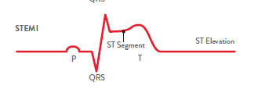
Diagnosis of MI: importance of biomarkers
However, fears of “missing” an MI mean patients are frequently kept for observation and testing costing billions of dollars annually¹
DIAGNOSING MI IS NOT ALWAYS SIMPLE
Symptoms may not be typical even with MI
EKG may not show changes even with MI
Circulating biomarkers are thus critical in making the diagnosis of MI (“ruling in” MI) or excluding the diagnosis of MI (“ruling out” MI)^{2,3}
Troponins are the only biomarkers recommended for this purpose^{2,3,4}
About 25% of patients with MI are diagnosed from their EKG due to ST elevation or new left bundle branch block = STEMI, ST elevation MI
The other 75% with MI but not STEMI = “NSTEMI”, non ST elevation MI
People who do not have STEMI (= suspected NSTEMI) are discussed from this point on (the STEMI diagnosis is usually made without the need for biomarker results)
However that is only 25% of the 8-15% with suspected MI.
Storrow, AIM 2000
Amsterdam E et al, JACC 2014 (ACC AHA NSTEMI Guidelines)
Thygesen et al, JACC 2018 Fourth Universal Definition of Myocardial Infarction
Yau AA, Nguyendo LT, Lockett LL, Michaud E. Crit Pathw Cardiol. 2017 Dec;16(4):126-128
ADD-140731-USA-EN |
August 14, 2023

Slide 6
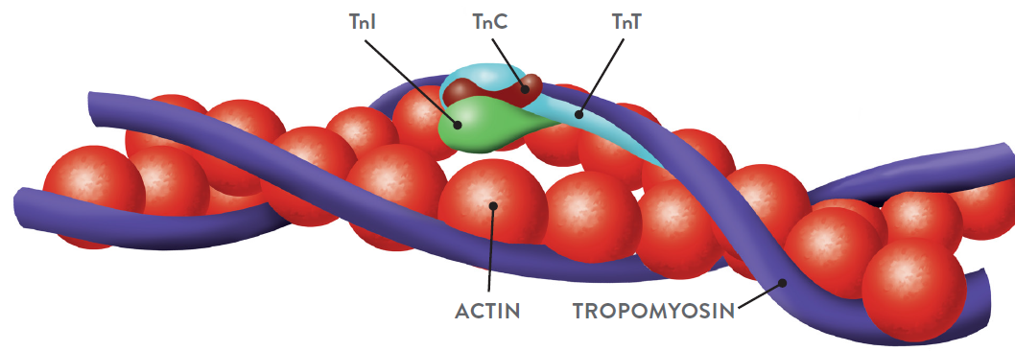
What is troponin? How is it used in suspected MI?¹
Troponin is a protein contained in the cardiac myocytes that facilitates myocyte contraction with three subunits: troponins C, T, and I: Troponin T and I are highly specific to cardiac muscle, I more so²
Levels become elevated (>99th percentile) when myocytes are deprived of oxygen = myocardial injury including (but not limited to) MI¹
Today, detection of an elevated level of troponin (> the 99th percentile) with a rising and/or falling pattern in the appropriate clinical setting forms the cornerstone of the diagnosis of MI¹
Notably, most apparently healthy individuals (not having an MI) have small but detectable concentrations of troponin, but at these low concentrations, only high-sensitivity (hs) assays can detect it
Thygesen et al, JACC 2018 Fourth Universal Definition of Myocardial Infarction
Wens et al Circ Genetics 2016
ADD-140731-USA-EN |
August 14, 2023

Slide 7
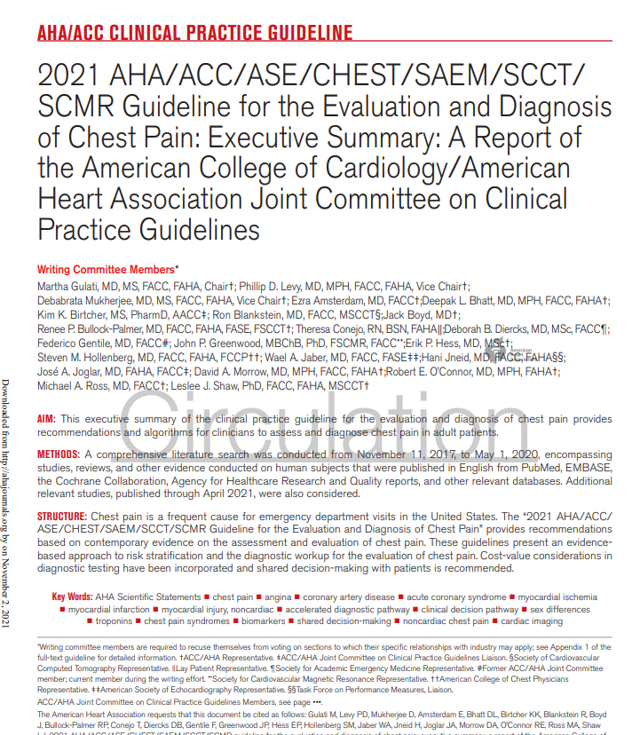
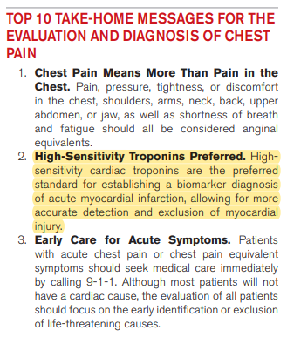
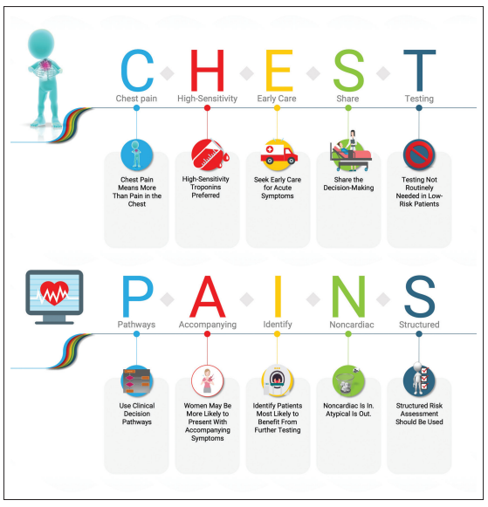
Guidelines for troponin in suspected MI: AHA/ACC¹
“high-sensitivity cTn is preferred because it allows rapid detection of myocardial injury and has increased diagnostic accuracy”
Gulati et al, 2021 AHA/ACC Clinical Practice Guideline
ADD-140731-USA-EN |
August 14, 2023
7

Slide 8
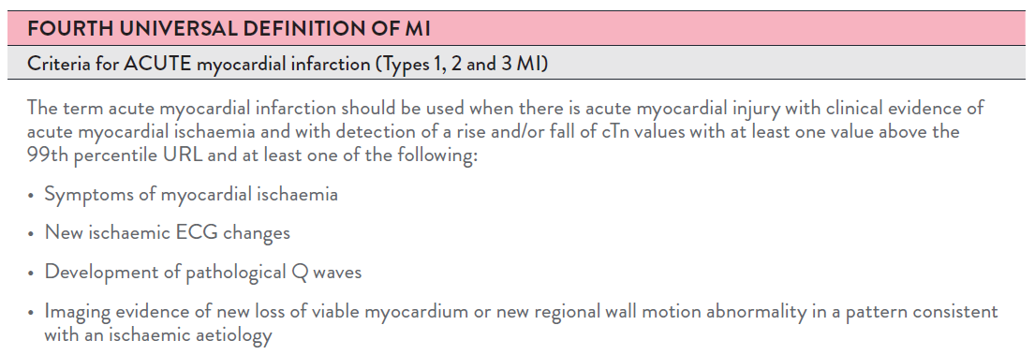
Guidelines for troponin in suspected MI: FUDMI¹
Rise and/or Fall of troponin with at least one value >99th %ile
ALL elevations >99th % are Myocardial Injury: must have rise/fall to be ACUTE
NOT ALL elevations are MI
Thygesen et al, JACC 2018 Fourth Universal Definition of Myocardial Infarction
ADD-140731-USA-EN |
August 14, 2023

Slide 9
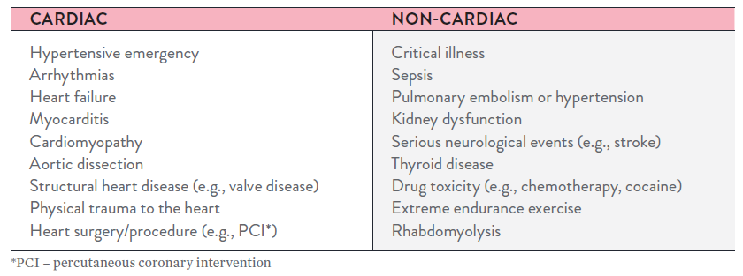
Numerous reasons for non-MI troponin elevations
Hoeller et al.; BMJ 2013
August 14, 2023

Slide 10
Non-MI troponin T elevations:
Skeletal muscle disorders (SMD) can cause elevations in cTnT not due to cardiac disease¹
hs-cTnT elevations are common in patients with active chronic non-inflammatory myopathy and myositis, but not other SMDs
hs-cTnT-Elecsys concentrations were significantly higher in patients with SMD versus controls
hs-cTnI concentrations were mostly similar
In patients with active chronic non-inflammatory myopathy and myositis, cTnI is the preferred analyte for assessing cardiac health in general and presence of AMI
Mueller et al.; Cardiac Troponins and Skeletal Muscle Disease; 10.1161/CIRCULATIONAHA.121.058489
ADD-140731-USA-EN |
August 14, 2023

Slide 11
High sensitivity vs. contemporary troponin assays
Alinity i STAT high sensitivity Troponin-i
ADD-140731-USA-EN |
August 14, 2023
11

Slide 12
How are hs troponin assays defined and reported?¹
IN 2012, A TASK FORCE CREATED BY THE INTERNATIONAL FEDERATION OF CLINICAL CHEMISTRY (IFCC) PROPOSED THAT HSTN ASSAYS BE DEFINED USING TWO PARAMETERS:
The total imprecision (coefficient of variation) at the 99th %ile should be ≤10%
Measurable concentrations below the 99th %ile should be attainable with an assay at a concentration value above the assay’s limit of detection (LOD) for at least 50% (and ideally >95%) of healthy individuals
In 2018, the Task Force expanded on this point by requiring both men and women individually attain measurable concentrations: at least 50% measurable concentrations above the assay’s LoD
IFCC also recommend that hs-cTn is reported in whole numbers, using ng/L without decimal points
It is crucial that clinicians are educated on the change in units
Wu et al, Clin Chem 2018
ADD-140731-USA-EN |
August 14, 2023
Notes:
Questions 4 & 5: identify differences between ng/mL vs ng/L and explain why hsTnI results are reported in whole numbers

Slide 13
Limitations of contemporary troponin assays
CONTEMPORARY (NON HS) TROPONIN I AND T ASSAYS ARE STILL IN WIDESPREAD USE IN US
Very reliable for detecting troponin levels > 99th percentile of an apparently healthy reference population¹ but may not be able to detect elevations as quickly or precisely as high sensitivity assays²
POTENTIALLY REQUIRE EXTENDED TIME TO DETECT TROPONIN WHICH MAY LEAD TO:
Delay in the diagnosis of MI
Delay in treatment for patients ultimately diagnosed with MI: “time is muscle”
Particularly vulnerable are those with lower circulating levels of troponin
e.g. Women and Early presenters (present with <2-3 hours of symptoms)³
HIGH SENSITIVITY ASSAYS CAN DETECT ELEVATED CTNI (> 99TH %) WITHIN 3 HRS AFTER THE ONSET OF CHEST PAIN⁴
Jarolim P. Clin Chem Lab Med. 2015; 53(5): 635-652
Wu et al, Clin Chem 2018
Thygesen et al, JACC 2018 Fourth Universal Definition of Myocardial Infarction
Thygesen K, et al. EHJ 2012;33(18):2252-2257
ADD-140731-USA-EN |
August 14, 2023

Slide 14
Limitations of contemporary troponin assays
CONTEMPORARY (NON HS) TROPONIN I AND T ASSAYS
Cannot reliably report levels well below the 99th %ile
Result may appear similar whether true levels of troponin were very low or rising rapidly
For example, where presentation = 0 hrs
“<28 ng/L” and 3 hrs later “<28 ng/L” could represent true values such as
0 hrs 5ng/L, 3 hrs 6 ng/L or
0 hrs 5ng/L, 3 hrs 16 ng/L
Clinicians are aware of limitations of current paradigms and may keep patients for observation and testing for extended periods of time, leading to increased length of stay and cost¹
ABBOTT Alinity HIGH SENSITIVITY TROPONIN I ASSAY CAN REPORT LEVELS OF CTNI AS LOW AS 2.7 NG/L (LOQ)
Thygesen et al, JACC 2018 Fourth Universal Definition of Myocardial Infarction
Alinity i STAT High Sensitivity Troponin-I Package Insert: H14937R02
ADD-140731-USA-EN |
August 14, 2023

Slide 15
Contemporary troponin^{1,2,3,4}
Not Measureable!
Frequency
Limit of Detection
10% CV
Troponin Level
99th Percentile
Representative cartoon for contemporary assays
1. Apple, F.S., et al. Clin Chem, 2012; 58(1) :54–61
2. deFilippi, C., et al. JAMA, 2010; 304(22): 2494-2502
3. Saunders, J. et al. Circulation, 2011; 123: 1367-1376
4. Atherton, JJ., et al. JACC Cardiovasc Imaging, 2010; 3: 421-428
Notes:
So Why is it so important to have measurable values above the LoD?
The higher the sensitivity of the assay, the more frequently Tn measurements in healthy subjects will be detected. Detected is defined by any measurement above the lower limit of detection (LoD), i.e., noise of the assay.¹⁻²
Studies have suggested that elevated troponin values, even below the upper limit of normal (i.e., 99thpercentile) of a healthy reference population are of prognostic importance and are linked to worse clinical outcomes.³⁻⁶
References:
1. Apple FS., Clin Chem. 2009; 57(7): 1303-13006
2. Apple, F.S., et al. Clin Chem, 2012; 58(1) :54–61
3 .deFilippi, C., et al. JAMA, 2010; 304(22): 2494-2502
4. Saunders, J. et al. Circulation, 2011; 123: 1367-1376
5. Atherton, JJ., et al. JACC Cardiovasc Imaging, 2010; 3: 421-428
In this representative cartoon, contemporary sensitive Troponin assays have higher LoD and in some cases are close to the 99thile resulting in not picking up measurable values of Troponin in a normal population.

Slide 16
High sensitivity troponin
Not Measureable!
Frequency
Cotemporary LoD
High-Sensitivity LoD
10% CV of Contemporary Tnl
Troponin Level
10% CV of hsTnl
99th Percentile
Representative cartoon for high-sensitivity assays

Slide 17
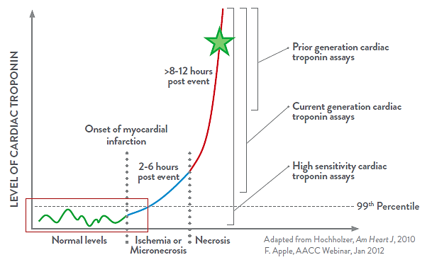
Contemporary vs hs troponin assays
Previous generation and contemporary troponin assays cannot detect troponin increases as quickly as high-sensitivity troponin assays
ADD-140731-USA-EN |
August 14, 2023

Slide 18
Alinity hsTnI meets IFCC criteria for hs assay
Alnity i STAT_hsTnI Precision at 99th Percentile
 | Mean (ng/L) | Coefficient of Variation (CV)**
Sample 5 | 13.9 | 2.7%
Sample 6 | 15.1 | 4.3%
Sample 7 | 18.2 | 4.5%
Sample 8 | 20.2 | 3.7%
Sample 9 | 36.9 | 3.2%
**Includes within-run and between-run variability.
<5% CV
near medical decision points
≥50%
Percent detected using ARCHITECT hsTnI in
healthy population studies¹
Alinity i STAT High Sensitivity Troponin-I Package Insert: H14937R02
Abbott data on file

Slide 19

ARCHITECT TnI and hsTnI_STAT and Alinity i hsTnI_STAT
 | ARCHITECT STAT TnI (LN 2K41) | ARCHITECT hsTnI_STAT (LN 2R98) | Alinity i hsTnI_STAT (LN 4Z21)
 | pg/ml (ng/ml) | Ng/L | Ng/L
Analytical Sensitivity/LoD | 10* | 1.7** | 0.9***
LoQ | N/A | 3.5 | 2.7
10% CV¹ | 32 | 4.6 | > 3.5
99th percentile (overall) | 28 | 28 | 27
99th percentile (male) | 33 | 35 | 35
99th percentile (females) | 13 | 17 | 14
% Detectable above LoD² | <50% of normal | >50% of normal | >50% of normals
LoB | N/A | 0.9 | 0.0
Sample tube type | Li Heparin Plasma | K2 EDTA Plasma | Li Heparin Plasma
Improved sensitivity with lower LoD
Improvement in the 10% CV concentration without significant change to 99th percentile
Need for sex specific cutoffs
***Alinity i High Sensitivity Troponin-I Package Insert: H14937R02
*ARCHITECT STAT TnI Package Insert: G10467R11
**ARCHITECT STAT High Sensitivity Troponin-I Ho3755/R01
Data on file at Abbott
Apple FS, Collinson PO. Analytical characteristics of high-sensitivity cardiac troponin assays. Clinical Chemistry. 2012;58(1):54-61
ADD-140731-USA-EN |
August 14, 2023
Notes:
The LoB represents the 95th percentile from n ≥ 60 replicates of zero-analyte samples.
^{b} The LoD represents the lowest concentration at which the analyte can be detected with 95% probability based on n ≥ 60 replicates of low-analyte level samples.
^{c} The LoQ presented in the table is in alignment with the low end of the AMI for the ARCHITECT STAT High Sensitivity Troponin-I assay. The observed LoQ on the ARCHITECT i System was 2.3 ng/L (2.3 pg/mL). This LoQ is defined as the lowest concentration at which a maximum allowable precision of 20 %CV was met and was determined from n ≥ 60 replicates of low-analyte level samples.
EDTA was used to ARCH b/c that was the only data we had for sample type studies
Li Hep is the most used tube in ER
On going efforts to add tube types, but decision was made with Li Hep as to not jeopardize approval

Slide 20
Interfering substances
Alinity i STAT high sensitivity Troponin-I
ADD-140731-USA-EN |
August 14, 2023
20

Slide 21
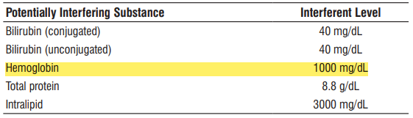
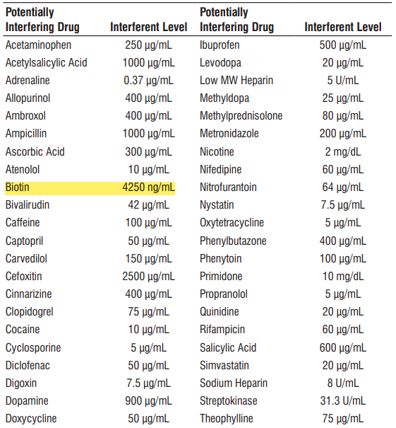
Interfering substances
Alinity i High Sensitivity Troponin-I Package Insert: H14937R02
August 14, 2023

Slide 22

Hemolysis interference is an important consideration for choice of hsTnI assay
Hemolysis is known to cause interference in both TnT and TnI assays¹
Effects become even more important with the emergence of more sensitive troponin assays and the increased reliance on interpretation of small absolute changes¹
Hemoglobinemia and hyperbilirubinemia may produce either false-positive or false-negative troponin levels, depending on the assay used and the form or subunit of troponin measured²
Florkowski C, Wallace J, Walmsley T, George P. The effect of hemolysis on current troponin assays--a confounding preanalytical variable? Clinical Chemistry. 2010;56(7):1195-1197.
Means Jr. RT( 1 ), Masimasi N. Elevated troponin levels associated with hemolysis. American Journal of the Medical Sciences. 330(4):201-203.
ADD-140731-USA-EN |
August 14, 2023

Slide 23
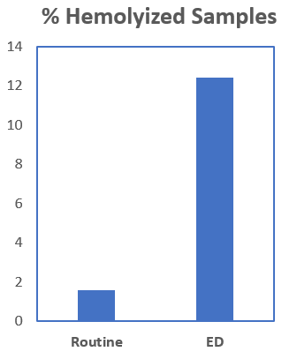
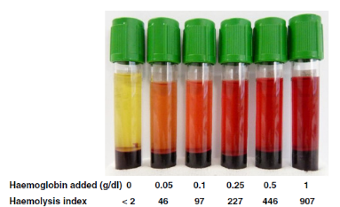
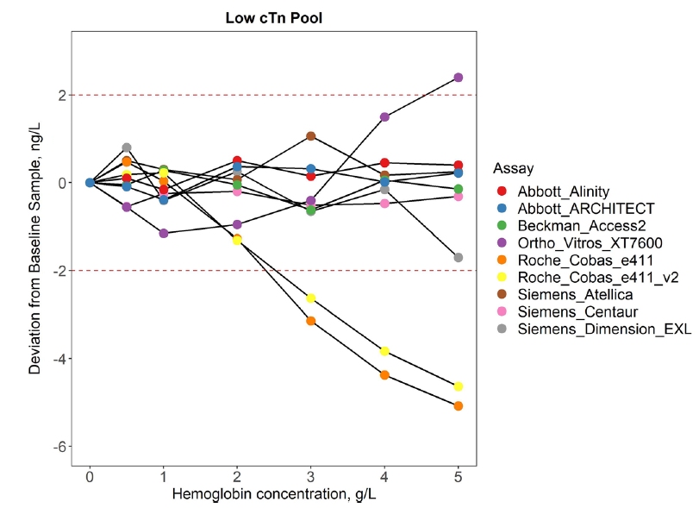
Hemolysis interference with troponin assays
Hemolysis is seen more frequently in samples from ED (12.4%) compared to routine samples (1.6%)¹
Susceptibility to hemolysis²:
  can provide inaccurate results
  require a redraw
  Increase time to diagnose
  create lack of confidence in results
Burns ER, Yoshikawa; Laboratory Medicine; 2022; 33(5):378-380
Harley K etal. Clin Chem Lab Med; 2021

Slide 24
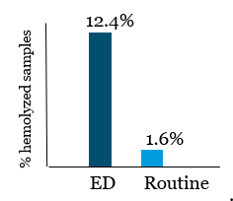
Emergency department samples have a higher incidence of hemolysis compared to routine
Hemolysis in samples drawn in the Emergency Department (ED) is significantly more frequent than samples drawn in routine situations¹
Evaluation of hemolysis in ED samples requesting high sensitivity troponin measurement²
  7% samples had Hb >0.1g/dL (competitor claim)
  Only 0.5% samples had Hb>0.5g/dL
Burns ER, Yoshikawa N. Hemolysis in serum samples drawn by emergency department personnel versus laboratory phlebotomists. Laboratory Medicine. 33(5):378-380
Brunel V, Larson T, Peschanski N, Cauliez B. Evaluation of hemolysis in emergency department samples requesting high sensitivity troponin T measurement. Annals Of Clinical Biochemistry. 2012;49(Pt 5):509-510
ADD-140731-USA-EN |
August 14, 2023
Notes:
The reference to 7% is clearly stated in the letter… “According to the hsTnT manufacturer’s recommendations, haemolysis would impact up to 7% of our emergency department samples.” This is because as Roche state in their pack insert “Falsely depressed results are obtained when using samples with hemoglobin concentrations > 0.1 g/dL” this gives a massive change of 20%.... ”Criterion: Recovery within ± 20 % of initial value at troponin T concentrations”. Note that the ARCHITECT hsTroponin assay says haemolysis interference occurs above 0.5 g/dL (500mg/dL) with a smaller 10% change criteria.
In Brunel the prevalence of haemolysis above 0.1 g/dL was found to be 7% (in the graphic 4.6% + 2% + 0.5% = 7.1%) , and above 0.5g/dL was found to be 0.5%, this is clear from the graphic.
So given the representative haemolysis prevalence data in the Brunel study …. 7% or 1in 14 samples from the ED are unsuitable because of hemolysis for Roche hsTnT vs only 0.5% or 1in 200 samples from ED for the Abbott hsTnI assay. If an ED sent 70 samples a day for troponin, then 5 times a day (70/14) the lab would ring ED and say take another sample for Roche vs only ring the ED once every 3 days for Abbott (70/200 = 1/3).

Slide 25
Performance and specifications
Alinity i STAT high sensitivity Troponin-I
ADD-140731-USA-EN |
August 14, 2023
25

Slide 26
Alinity i hsTnI methodology
This assay is an automated, two-step immunoassay for the quantitative determination of cTnI in human plasma (lithium heparin) using chemiluminescent microparticle immunoassay (CMIA) technology.
Sample and anti-troponin I antibody-coated paramagnetic microparticles are combined and incubated.
The cTnI present in the sample binds to the anti-troponin I coated microparticles.
The mixture is washed.
Anti-troponin I acridinium-labeled conjugate is added to create a reaction mixture and incubated.
Following a wash cycle, Pre-Trigger and Trigger Solutions are added.
The resulting chemiluminescent reaction is measured as a relative light unit (RLU). There is a direct relationship between the amount of cTnI in the sample and the RLU detected by the system optics.
Alinity i High Sensitivity Troponin-I Package Insert: H14937R02
August 14, 2023

Slide 27
Alinity i hsTnI methodology
August 14, 2023

Slide 28
Alinity i STAT High Sensitivity Troponin-I assay
Method & Format | 2-Step CMIA Assay with STAT protocol capability
Result Unit | ng/L; alternative SI unit = pg/mL
Reportable Interval | AMI = 2.7 – 3600.0 ng/L EMI = 3600.0 – 60,000.0 ng/L
Time to First Result¹ | STAT 18 min
Control Levels² | Low: 20 ng/L; 12.0 – 28.0 ng/L Medium: 200 ng/L; 120.0 – 280.0 ng/L
LoQ | 2.7 ng/L
LoD | 0.9 ng/L
LoB | 0.0 ng/L
99th Percentile | Overall = 27 ng/L Females = 14 ng/L Males = 35 ng/L
Specimen Type | Plasma: Lithium Heparin
Sample Volume | 160 uL
Alinity i High Sensitivity Troponin-I Package Insert: H14937R02
Alinity Systems Operation Manual 96211-119
Alinity i hsTnI Control Package Insert
ADD-140731-USA-EN |
August 14, 2023
Notes:
LoQ: is used as lowest cutoff.
LoD: used to qualify assay to be high sensitivity, >50% healthy population

Slide 29
Specimen specifications
Specimen Type | Temperature | Max Storage Time | Special Instructions
Plasma – Lithium heparin with or without separator | Room temperature (15-30^{oC}) | 8 hours | Specimens may be stored on the red blood cells.
Only plasma tubes containing dried lithium heparin have been validated for use with this assay.
Other specimen types and collection tube types have not been verified with this assay.
Performance has not been established for the use of cadaveric specimens or the use of body fluids other than human plasma.
The instrument does not provide the capability to verify specimen type. It is the responsibility of the operator to verify that the correct specimen types are used in the assay.
Alinity i High Sensitivity Troponin-I Package Insert: H14937R02
ADD-140731-USA-EN |
August 14, 2023

